Slide 1







INTEGRATED
HEALTHCARE
COORDINATION PLATFORM
TEAM NAME
COLLEGE NAME, CITY,
STATE

Slide 2






PROBLEM STATEMENT
Despite advancements in healthcare, coordination challenges remain a major issue , particularly in the gap between hospital-to-hospital communication , as well as between hospitals and patients. During pandemics and emergencies , these gaps become even more pronounced , leading to significant suffering. However, these issues persist even during regular times, exposing the deep-rooted nature of the problem.
For Administrators:
Difficulty in tracking and allocating ICU beds efficiently across hospitals.
Inefficient mechanisms for transferring patients in critical condition, such as when there are no beds available in a hospital.
Limited collaboration and resource sharing between hospitals, lead to fragmented care and inefficient utilization of resources.
For Patients:
Lack of real-time access to critical resources such as blood, organ donors, and essential medicines.
Delayed care due to miscommunication and disorganized systems, exacerbates the gap between patients and timely treatment.
These ongoing challenges underline the urgent need for a unified platform to bridge the gap between hospital-to-hospital coordination, streamline communication, and improve resource accessibility, ensuring more effective and timely care delivery.
HEALTHCARE
DOMAIN

Slide 3


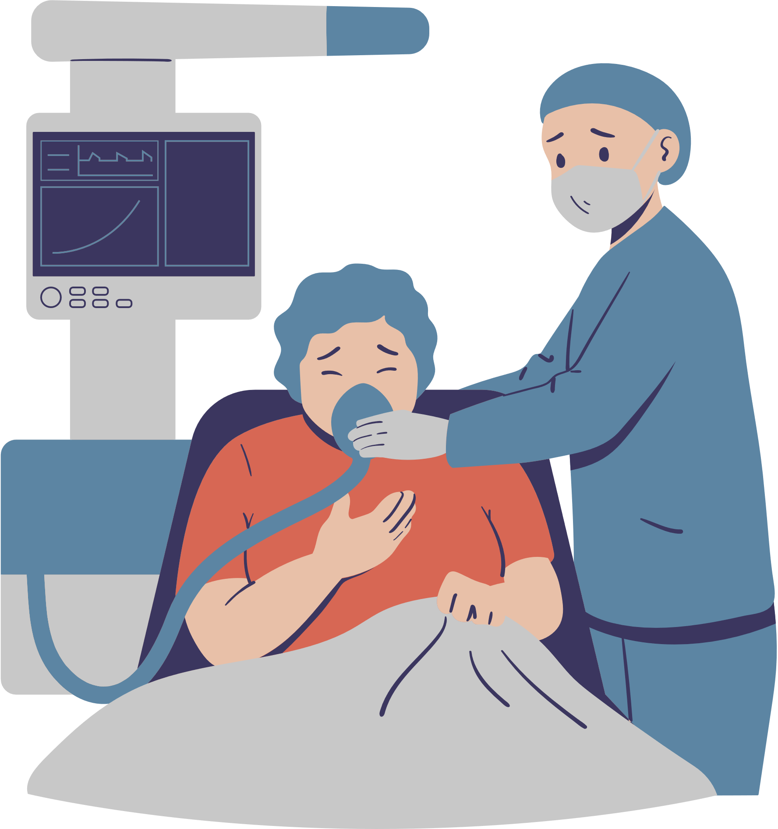







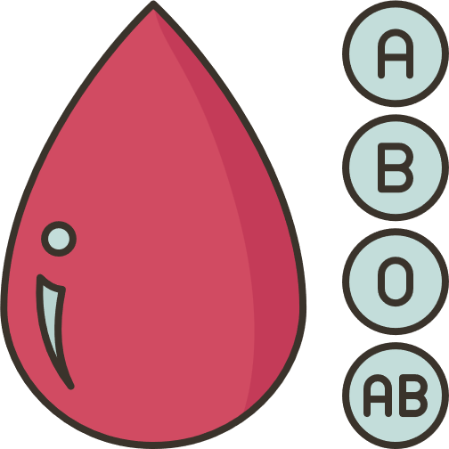


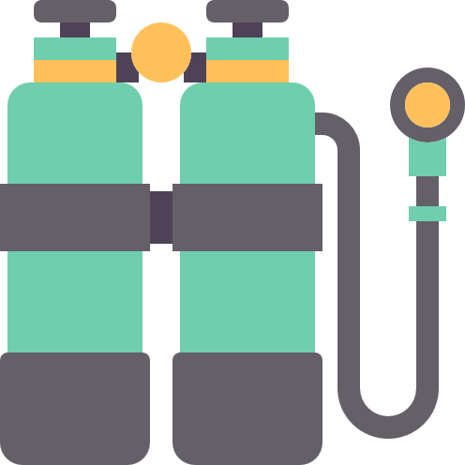






PROPOSED SOLUTION
To address these challenges, we propose an Integrated Healthcare Coordination Platform that bridges the gap between hospital administrators and patients. This unified system enables seamless collaboration, efficient resource management,
and real-time access to critical healthcare information, ensuring timely and effective healthcare delivery.
Better patient transfer
Bilateral hospital Collaboration
Efficient Resource Management
Enhanced Real-Time Access
Emergency Alerts
Data and Report for Betterment of Healthcare facilities
Usage Scenarios
Key Features
Social Impact
Innovation
Locating ICU beds and ventilators during medical emergencies
Real-time ICU bed and resource tracking
Faster emergency responses, saving lives during crises
Seamless integration of hospital networks and patient interfaces
Coordinating patient transfers between hospitals for specialized treatment
Dynamic doctor availability scheduling
Reduced stress for families through transparent healthcare options
Analysis on Data for prediction of resource usage and availability
Finding compatible blood or organ donors for urgent medical needs
Emergency alert system for hospitals
Market Impact
Managing oxygen supply shortages in disaster-struck areas
Blood and organ donor network
Opportunity for adoption by healthcare systems globally
Tracking the availability of critical medicines during shortages
Report on resource and blood usage
Enhances hospital efficiency and patient satisfaction
Here we can write something attractive like a slogan or related text in two lines or one.
Here we can write something attractive like a slogan or related text in two lines.

Slide 4

FLOWCHART
Homepage
Signup or
Login
Hospital Services Availability
Admin
Update
Resources
Doctors
Availability Schedule
Data Update
Update
Schedules
Availability Search
We can write something here
User Traffic
Donor
Availability
Hospitals
Dashboard
Users can easily check dashboards
Donor Specification
Hospitals &
Doctors Window
Doctors
Dashboard
User
Doctors
Success Rate

Slide 5













3 LAYER-ARCHITECTURE
User
ReactApp
API
MongoDB
ReactApp
Hospital/Admin
View resource
& Dashboard
Store
Application Data
Presentation Layer
Application Layer
Data Layer
Data Store
Confirmation
Realtime
Data Update
Forward Application Data
Web Portal
User Management System
MongoDB
Fetch
Data
Edit Data
Update Resource &
Doctors Schedule
Forward Application Data
Real-Time Notification
Resource Management System
Data Warehouse
Realtime Status Update
Data Analytics
Scheduling System
Data Security
User
ReactApp
API
MongoDB
ReactApp
Hospital/Admin

Slide 6










ARCHITECTURE
TECHNICAL STRATEGY
PROTOTYPE
Frontend: The React.js is used for an interactive, responsive interface. Employ for real-time updates on ICU bed availability, doctor schedules, and medicine stock changes.
Backend: Express.js is used for server-side logic and API requests. Postman is integrated for efficient resource-intensive tasks, like blood donor and organ searches.
Integration: API is utilized to sync with hospital software, blood banks, and pharmacy networks. Develop API Routes for seamless microservice communication.
Database: MongoDB is employed to manage data such as patient profiles and medicine inventories. Ensures regular backups for data integrity and disaster recovery.
Deployment, Validation, and Privacy: Both the frontend and backend deployed on Google Cloud for efficient hosting and scalability. Use Docker for streamlined deployment and environment consistency.
https://drive.google.com/file/d/1brx9uXyKqk0YyI17P__T2QfQilTbd5R0/view?usp=sharing
Backend
Frontend
Integration
TECH STACK
Zod
Deployment
Validation & Privacy
Database

Slide 7

















IMPACT AND BENEFIT
Feasibility Analysis
Impact on Target Audience
Technology Readiness: Leveraging existing technologies such as real-time databases, APIs for hospital systems, and geolocation services.
01
Patients & Families
Healthcare Providers
Blood Banks &
Pharmacies
Society
Government & Policymaker
Faster access to critical healthcare resources reduces stress and improves outcomes during emergencies.
Overall improvement in healthcare efficiency and reduction in preventable deaths.
Simplifies resource management, allowing hospitals to focus on patient care which is beneficial.
Increased visibility and accessibility lead to better resource utilization.
Improved data collection leads to better public health policies.
Patients and Families: Faster access to critical healthcare resources reduces stress and improves outcomes during emergencies.
02
Healthcare Providers: Simplifies resource management, allowing hospitals to focus on patient care.
Ensuring real-time, accurate data while protecting patient information.
Resistance from hospitals and healthcare providers to share required data.
03
Timely access critical medical resources and equipments.
Streamlined coordination makes system integrated.
Realtime information enhances accessibility.
User friendly interface simplifies navigation.
Potential Challenges and Risks
01
02
03
04
Risk of system downtime during peak demand or heavy traffic.
Encouraging widespread use among the public, patients and providers.
Benefits of the Solution

Slide 8

THANK YOU
ABOUT TEAM
(NAME, BRANCH, YEAR, EMAIL ID,
MOBILE NUMBER)

